Slide 1
15Z704 - CRYPTOGRAPHY AND NETWORK SECURITY
Dr.N.Gopika Rani,
AP-SG,
Department of CSE.

Slide 2
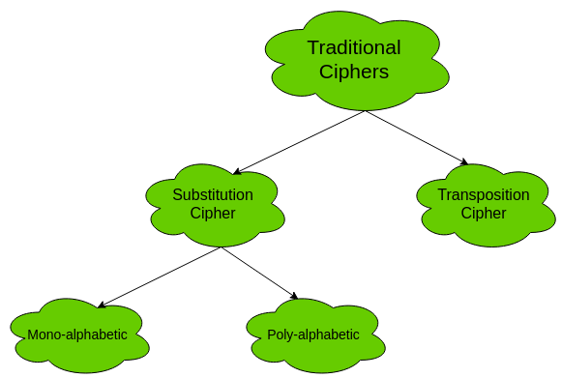
Traditional Symmetric Ciphers
The two types of traditional symmetric ciphers are Substitution Cipher and Transposition Cipher.
The following flowchart categories the traditional ciphers:

Slide 3
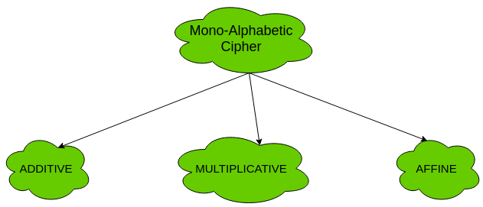
Types of mono-alphabetic ciphers are:

Slide 4
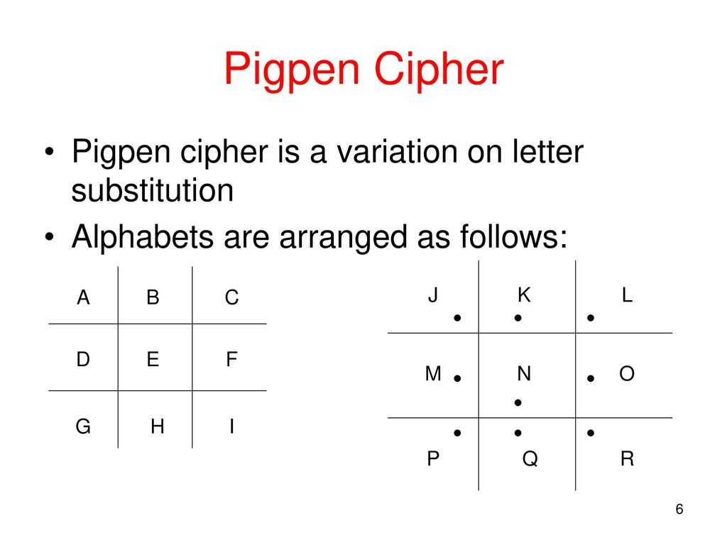

Slide 5
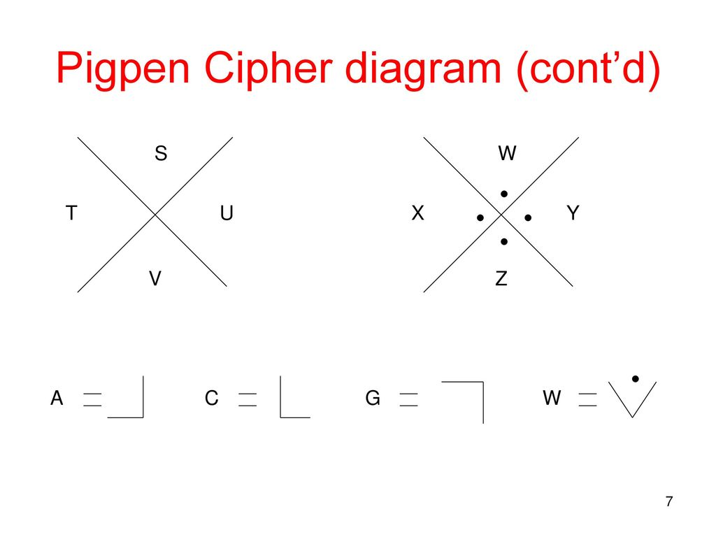

Slide 6
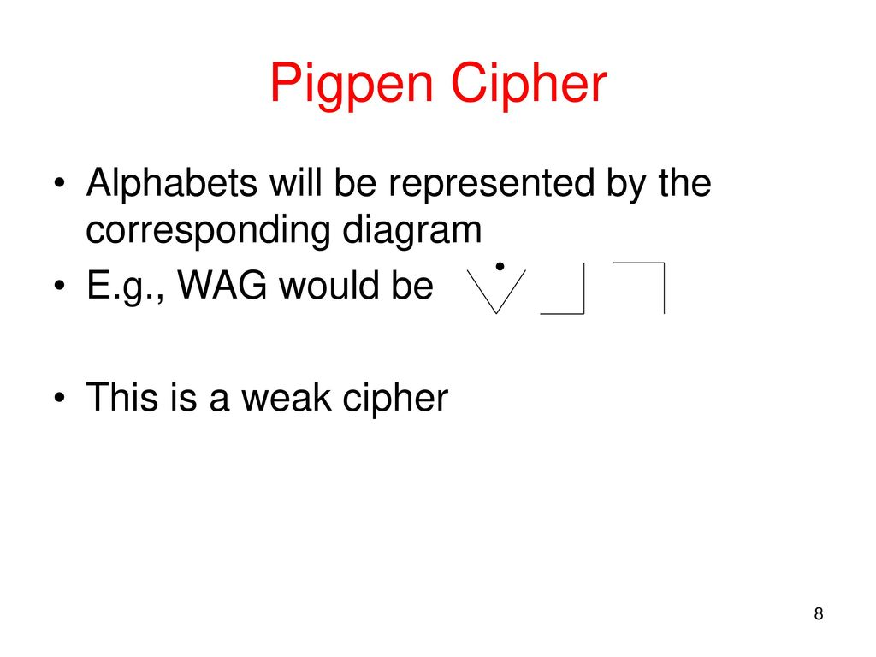

Slide 7
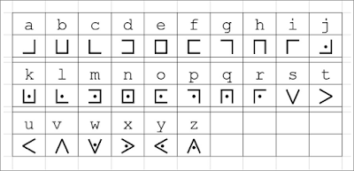

Slide 8

Decode the following pigpen ciphertext:
Encode the following message using the pigpen cipher:
the truth is out there

Slide 9
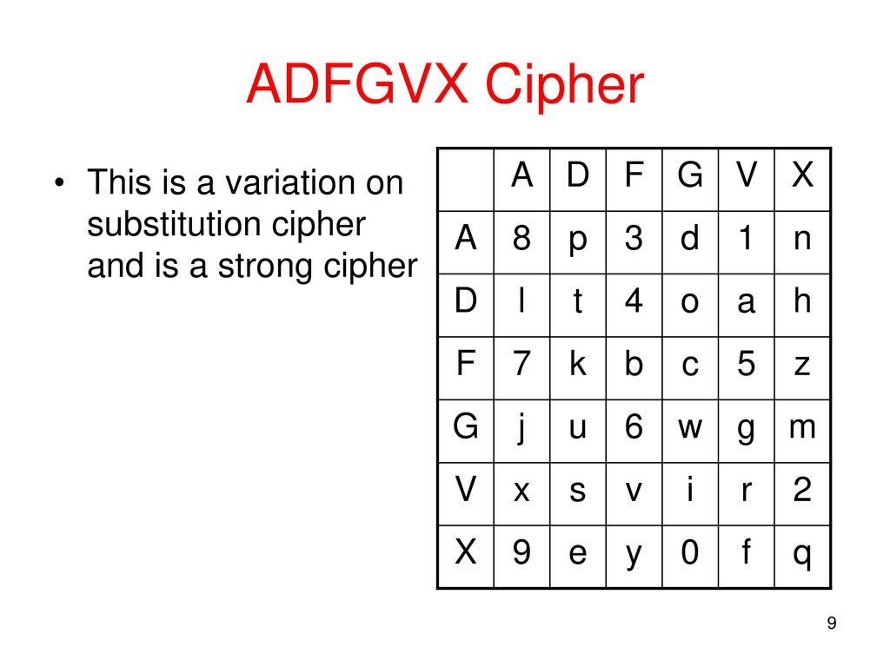

Slide 10
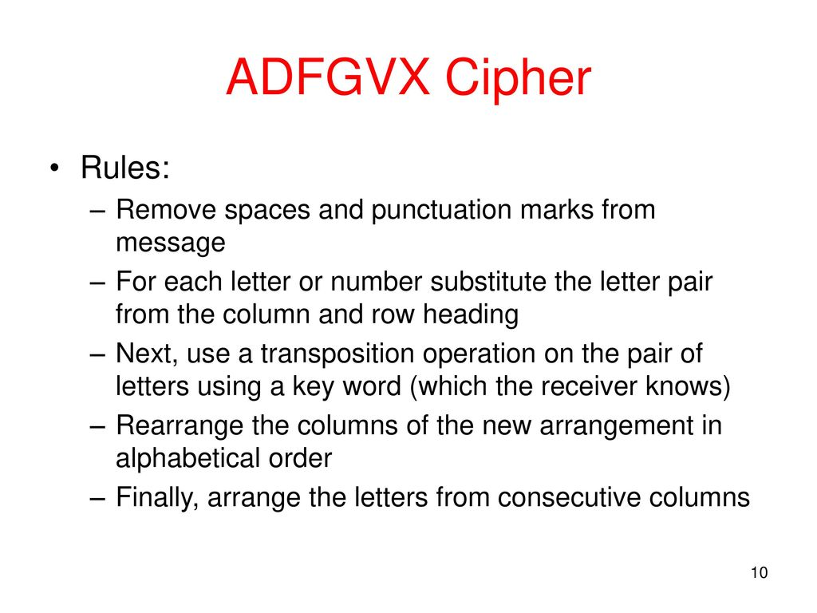

Slide 11
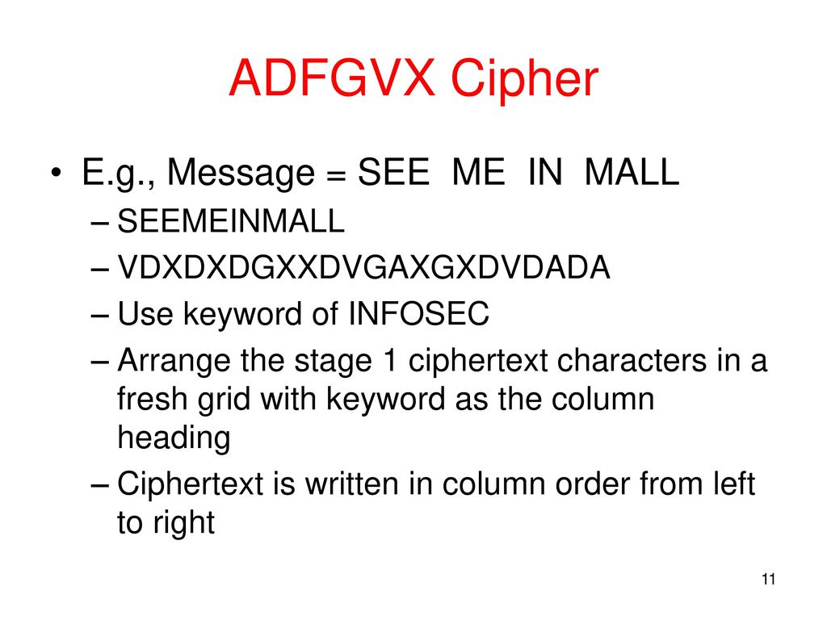

Slide 12
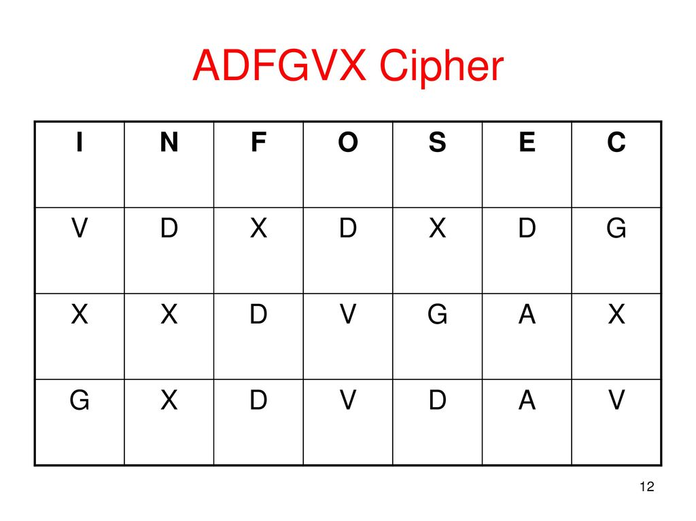

Slide 13
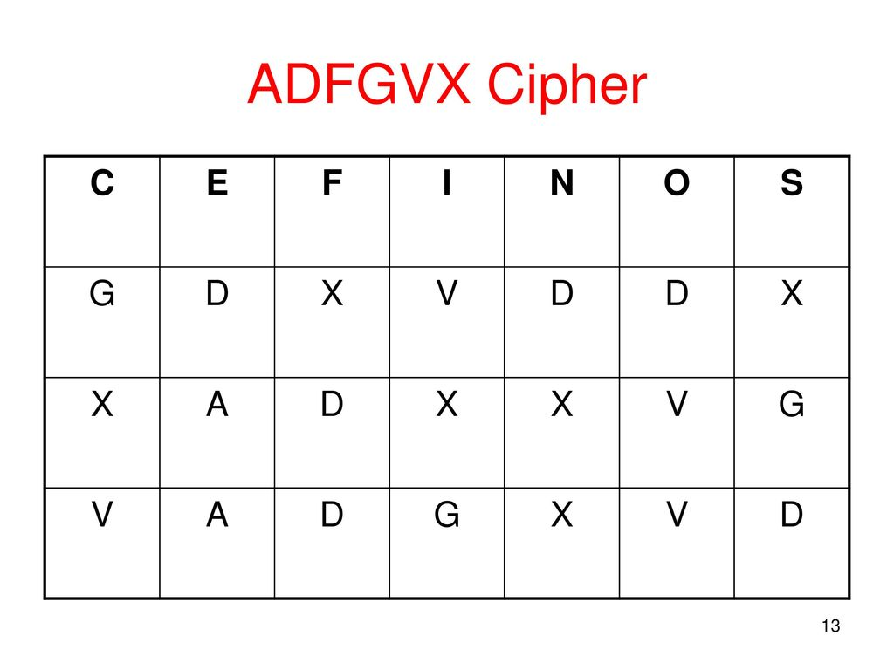

Slide 14
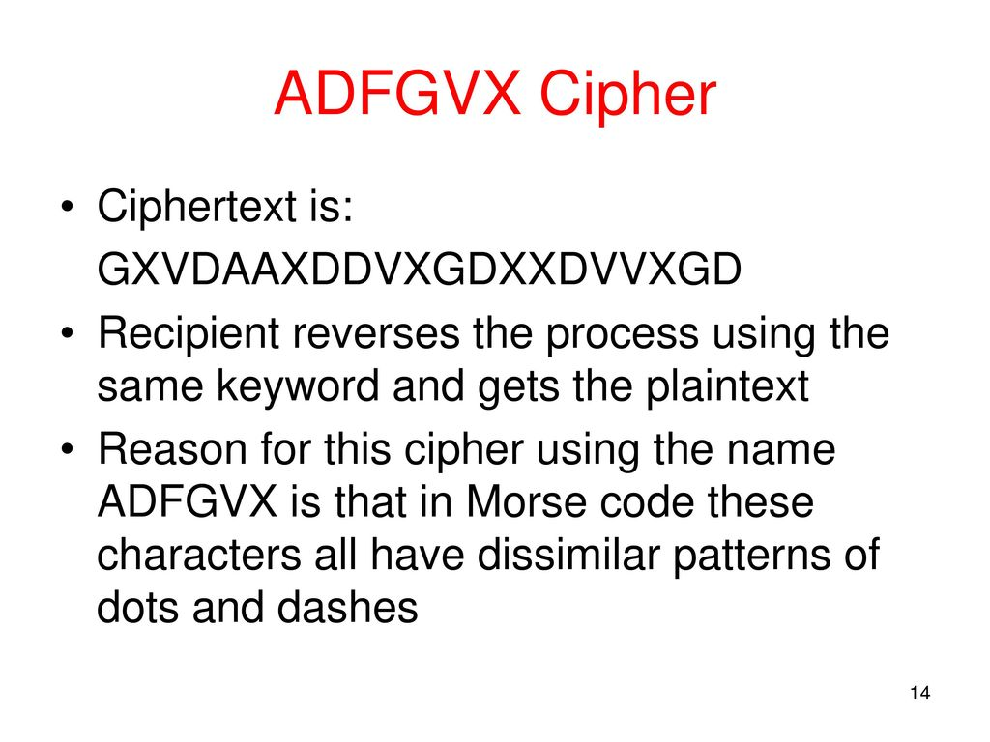

Slide 15
Multiplicative Cipher
The multiplicative cipher is similar to additive cipher except the fact that the key bit is multiplied to the plain-text symbol during encryption. Likewise, the cipher-text is multiplied by the multiplicative inverse of key for decryption to obtain back the plain-text.
C = (M * k) mod n
M = (C * k⁻¹) mod n
where,
k⁻¹ -> multiplicative inverse of k (key)
The key space of multiplicative cipher is 12. Thus, it is also not very secure.

Slide 16
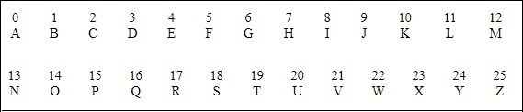
Multiplicative Cipher
If multiplication is used to convert to cipher text, it is called a wrap-around situation. Consider the letters and the
associated numbers to be used as shown below −
The numbers will be used for multiplication procedure and the associated key is 7. The basic formula to be used in such a scenario to generate a multiplicative cipher is as follows −
(Alphabet Number * key)mod(total number of alphabets)

Slide 17
